Slide 1
SMSC Macbeth
A Study in Conscience
The Not Quite Shakespeare Company

Slide 2
None can call our power to account

Slide 3
Lady Macbeth
In groups of three, work through the sleepwalking scene (Drama)
How is Lady Macbeth’s conscience troubling her?
If you were the Doctor, would you tell what you had seen? Explain.

Slide 4
Fundamental British Values
Take responsibility for your own actions
Obey the law of the land
Distinguish right from wrong

Slide 5
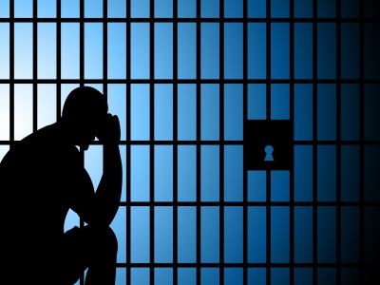
What is the cure for a bad conscience?

Slide 6
Revision
Look again at the Horror scene. How does Act 5 scene 1 relate to this?
The characters are suffering
The land is suffering – poisoned by the wrong-doing.
What is the cure for a bad conscience?
What is the cure for the land?

Slide 7
The Writer’s Craft
Writers often use the weather to reflect the situation. This is called pathetic fallacy
Eg an upset man and a rainy day
In Shakespeare plays, one theme is Nature. Unnatural acts are mirrored in unnatural actions of nature.
How would the birds act?
How would the fish in the pond act?

Slide 8
We are learning to use language for effect
What I’m looking for is a first person narrative
All will write a turmoil piece
Most will sustain writing in role
Some will use vocabulary for effect and clearly use techniques. Their characterisation will be deep.

Slide 9
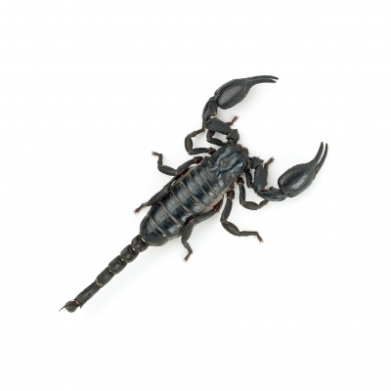
Full of scorpions is my mind

Slide 10
symbolism
Interpret that image. What could it mean?
Collate class answers on the board.
Can we see P.E.E?
Write down this answer as a model for analysing language.

Slide 11
Sustain your role
This is an image of Macbeth’s thoughts as he wrestles with the temptation to do murder – and the consequences of the act.
Use this as a stimulus for your own story. Base your story mainly in your character’s mind. You will be writing in the first person. You should consider
* Temptation * Inner struggle
* Consequences * Conscience

Slide 12
Success criteria
I occasionally use words for effect
I can use a range of imaginative vocabulary accurately
I use a varied vocabulary to create effects

Slide 13
Self Assessment: How can you improve?
Skim read your work.
Add interesting vocabulary
Add imagery
Lengthen some sentences
Have you used language for effect?

Slide 14
Romans 2 verse 15
They show the requirements of the law are written on their hearts, their consciences also bearing witness, and their thoughts now accusing, now defending. (NIV)

Slide 15
Knowing right from wrong
Guilt can lead to judgement and consequences.
Nevertheless, in groups of three work on The Price is Paid (Drama)
We like the concept of justice, so how is the Christian faith different?
Jesus is unique. Although others are the guilty ones, he is prepared to take the punishment meant for them – meaning that they can be free and blameless.

Slide 16
What is the result
We are not under law – but under grace.
The law would condemn us – but Jesus does not
(based on people being believers)

Slide 17
Full of scorpions is my mind
Scorpion Top View by Nuttapong freedigitalphoto.com

Slide 18
Jail copyspace represents taken into custody and arrest by Stuart Miles freedigitalphotos.com

Slide 19
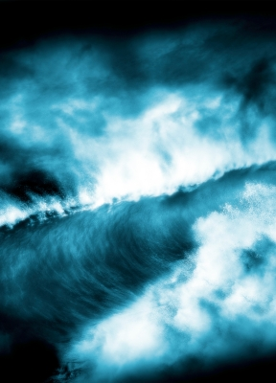
Rogue waves by victor habbick freedigitalphotos.com

Slide 20
None can call our power to account
Golden Crown by Digitalart freedigitalphoto.com

